Slide 1


DESIGNING A BETTER PATIENT EXPERIENCE
Notes:
Hi and welcome everyone to "Designing a Better Patient Experience!"; a webinar where we'll talk about user-centered design, how healthcare is becoming more and more patient-centered, and how we can work together to improve the patient experience overall.
[ Next ]

Slide 2
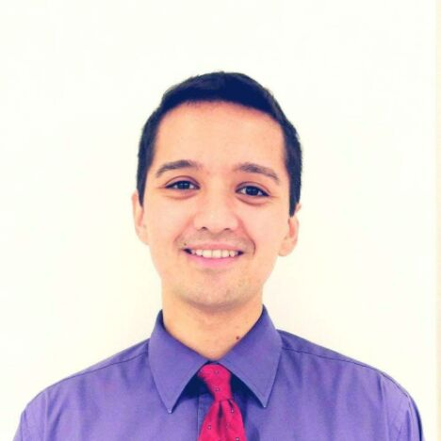


PRESENTERS
WILL GELDER
BRANDON MOORE
CLARE HICKS, RD
Service Designer
Product Designer
Business Analyst
Notes:
Brandon thinks maybe we should introduce ourselves? Maybe how long we’ve been working here? idk My name's Will Gelder - Service Designer, and with me today are Brandon Moore, a product designer, and Clare Hicks - Business Analyst.
Then will takes over:
Both of us endorse user-centered design best-practices and make it our jobs to empathize with our users, namely, patients, to promote a positive healing experience for them.
[ Next ]

Slide 3
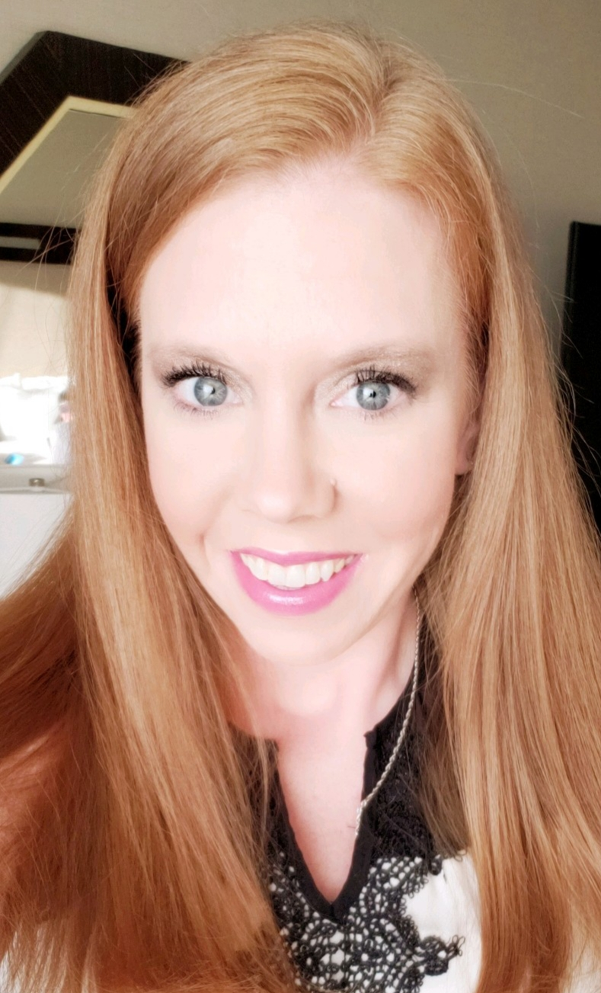
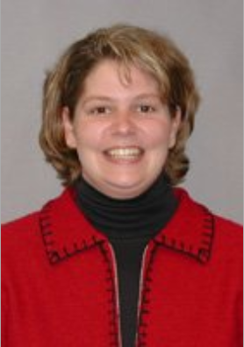
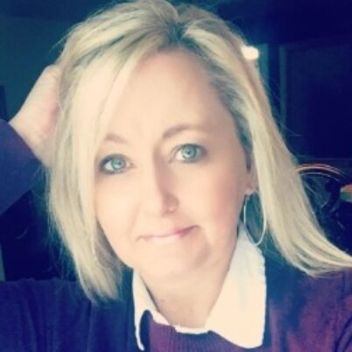

PANELISTS
Megan Moore, BSN, RN
Kate Klindt
Angela Mason-Epper
Will Ryan, Ph.D
Clinical Nursing Lead
Ohio Health
Product Owner
CBORD
Senior Product Instructor
CBORD
Director of User Experience
CBORD
Notes:
Near the end of the session, we'll have a group of expert panelists to do a Q&A session. More on them later.
[ Next ]

Slide 4
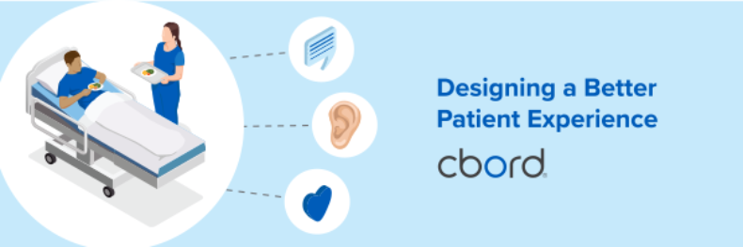

1
2
3
4
User-Centered Design
Design and Patient Care
CBORD Patient Design Research
Expert Panel
Notes:
Our main topics today include:
- high-level definition of Design
- user-centered design, a.k.a. patient-centered design
- Design in the context of Healthcare
- Our "CBORD Patient" product and our usability research process
- Expert Panel q&a
[ Next ]

Slide 5
Design
Notes:
Before we talk about user-centered design, we need to talk about design in general.
It's worth noting that YOU are practicing user-centered design within your jobs already.
Speaking with patients, answering their questions, ensuring that they're situated and cared for, taking and delivering their meals -- all of these touch points must be carefully considered to ensure that a patient feels as close to "normal" as they can, in a vulnerable situation.
[ Next ]

Slide 6
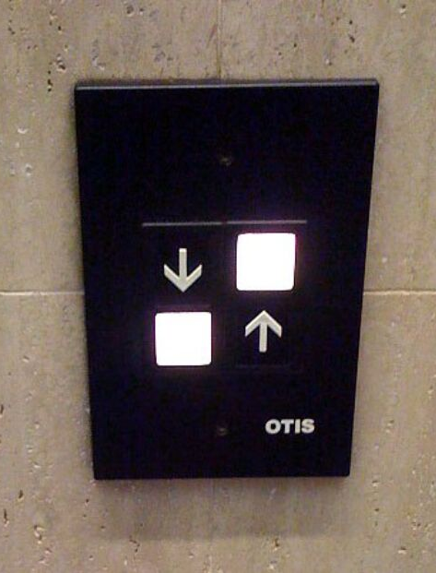
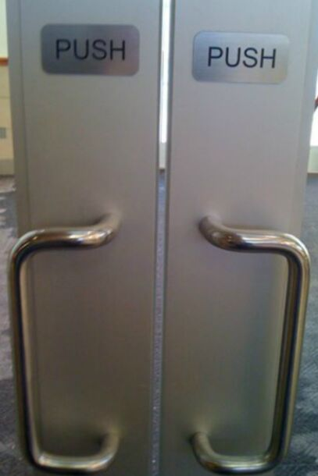
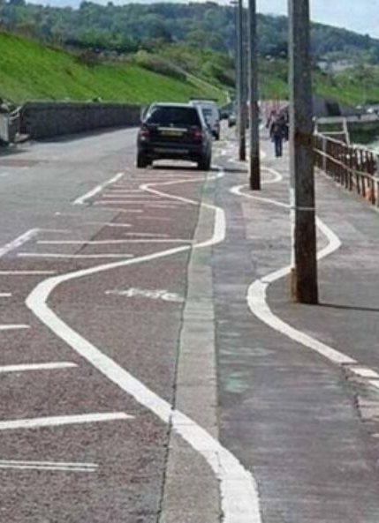
Poor Design
Confusing
Unintuitive
Dangerous
Notes:
- Poor design is easy to notice. It often sticks out because it calls attention to itself by being confusing, or being unintuitive, or worse-yet by being dangerous
- Usually, poor design stems from decisions made out of expedience, poor analysis, and limited-to-no feedback from actual users
[ Next ]

Slide 7
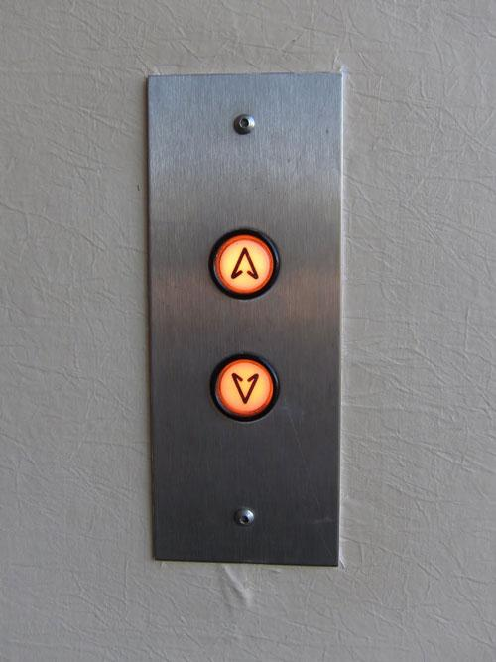
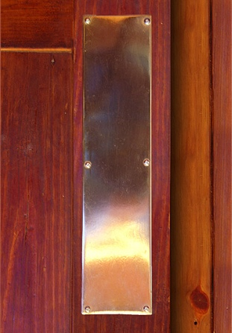
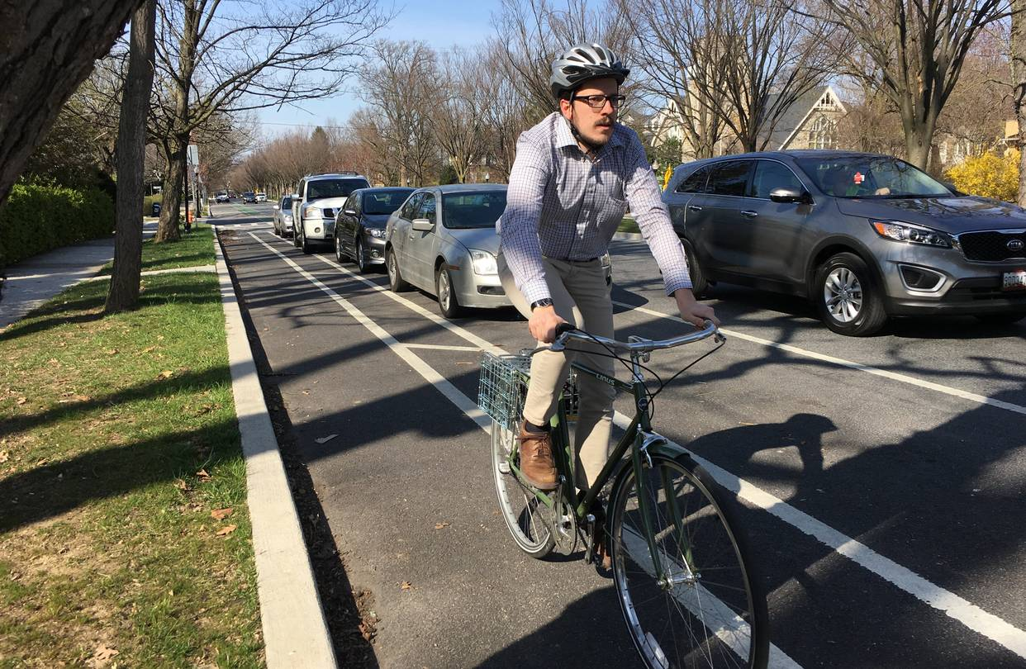
Good Design
Self-explanatory
Intuitive
Safe
Notes:
- Good design is often invisible. It's invisible because it lets you accomplish your goals in ways that are not intrusive and frictionless.
[ Next ]

Slide 8
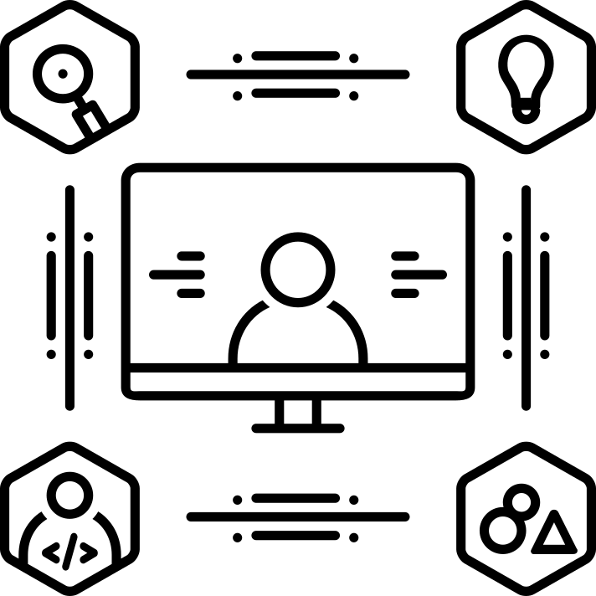
What is User-Centered Design? (UCD)
"... process in which designers focus on users and their needs in each phase of the design process."
- Interaction Design Foundation
https://www.interaction-design.org/literature/topics/user-centered-design
Notes:
- That's design in general, now let's shift the perspective to talk about user-centered design applied to the healthcare space. Simply replacing the word "user" with "patient".
- I have a quote from the interaction design foundation, which defines user-centered design: "... process in which designers focus on users and their needs in each phase of the design process."
- I'll rephrase this to talk about patient-centered design. "...process in which patient care teams focus on patients and their needs at each stage of their healing.
- And you can start to gather, user-centered design is already being leveraged within the healthcare space. We at CBORD want to become partners with you to ultimately reduce friction at various touch points in the patient care experience.
[ Next ]

Slide 9

Designing with Empathy
Notes:
- By partnering with us, know that our team, at its very core, empathizes with patients. We all know, or have been that someone in the hospital. It's an alienating experience, to say the least.
- And so when we are designing for the patient, we're taking into account the sights, smells, and sounds that a patient would likely experience.
- These factors will often make or break certain design decisions. Someone who suffers from vertigo may not be able to handle complex animation and movement onscreen. Someone with Parkinson's Disease may not be able to accurately press a tiny button. Someone with color blindness may not be able to distinguish between a warning color versus a success color.
[ Next ]

Slide 10

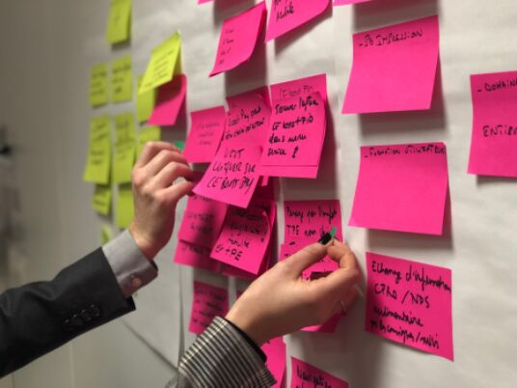

UCD Activities (but not limited to...)
Interviews
Journey Mapping
Usability Testing
The CBORD Group, Inc.| User-Centered Design
Notes:
- So, how do we at CBORD identify our users, their pain points, and design? There are a number of activities used.
- Interviewing your end users throughout the process will yield a wealth of insights. Especially during the early phase
- Journey mapping is another technique where you and your users will identify the steps and paint points throughout a given process. For example, what is the meal ordering experience like for a patient today? "Someone darted in, gave me a menu, and darted out. I wasn't sure what I was allowed to eat. Nor when the tray would arrive."
- And then once we have an idea for a solution, we'll prototype it and do a couple rounds of usability testing to validate or invalidate that our solution addresses their core problems.
[ Next ]

Slide 11
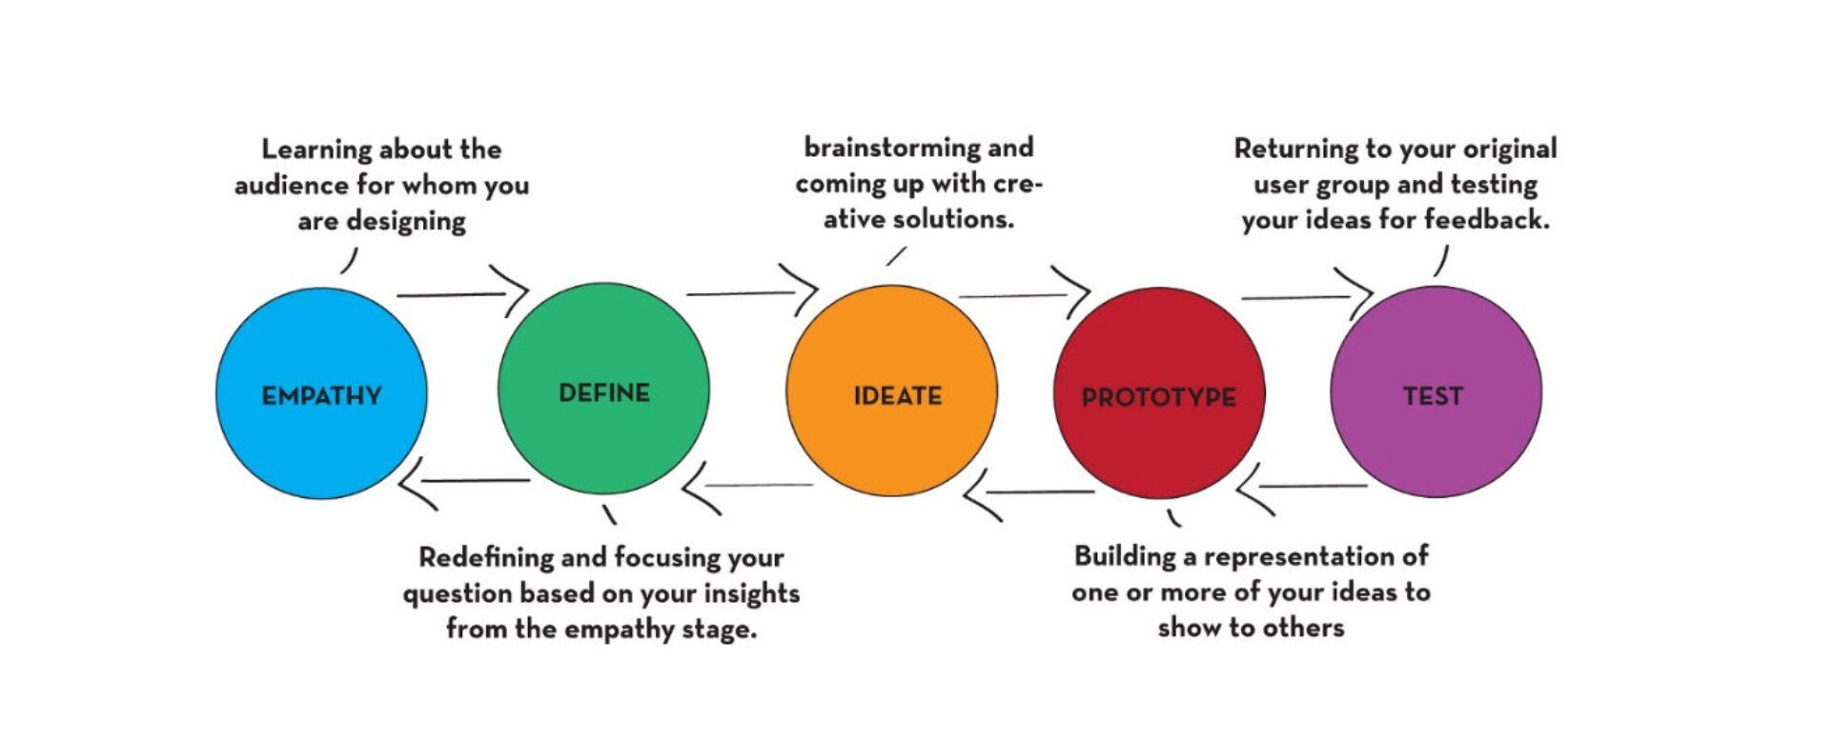
Notes:
- All this is a cyclical and iterative process
- The crucial aspect is closing the loop with the actual user, in this case, the patient and getting their feedback to ensure that they're being heard.
- In this way, the patient becomes part of their own healing process.
- So, to talk more specifically about patient experience, at this point I'd like to hand it over to Clare!
[ Next ]

Slide 12
What about Patient Care?
Notes:
CLARE: Some of you may be thinking right about now that this is all really interesting, but what does it have to do with taking care of patients and the patient experience? Healthcare has undergone so much technology change in recent years, perhaps more rapidly and thoroughly than any other industry. And yet there are very few other industries with as much incentive to really get things right, because of course there are lives on the line. One of these changes has been EHR adoption. In the case of EHRs, technology has the ability to reduce human error by eliminating poor handwriting, handling complex equations, and automate certain reminders. But when technology is created without considering Human Factors, it has the potential to do great harm.

Slide 13

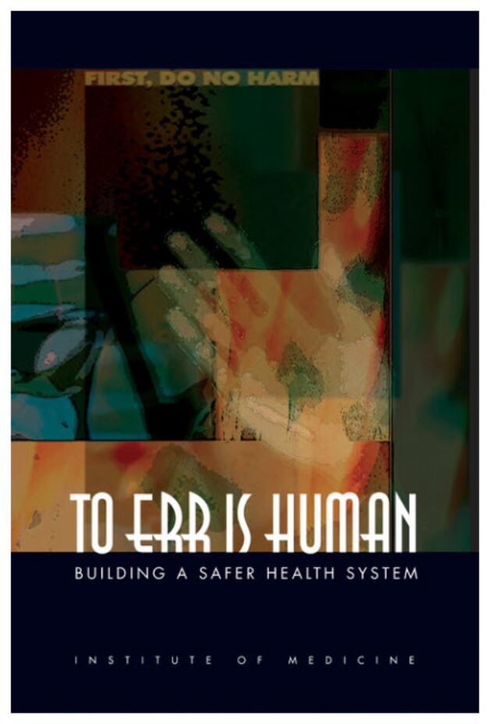
To Err is Human
Building a Safer Health System
https://www.ncbi.nlm.nih.gov/books/NBK225182/
Notes:
CLARE: There is an often-referenced report from the Institute of Medicine in 1999 called To Err Is Human that discussed the rates of medical error in the US. Because the death rates of medical error were so high that people had trouble conceptualizing, it was later compared to the equivalent of one jumbo passenger jet crashing every single day. And when they dug into why these errors occur, they discovered that it's not that people who work in healthcare are negligent. Not at all. Rather - the system wasn't designed to reduce human error.
In order to reduce deaths from medical error, we need to design a safer health system.

Slide 14

EHRs Safety and Usability
See What We Mean
Medstar Health
National Center for Human Factors in Healthcare
https://ehrseewhatwemean.org/
Notes:
CLARE: There is a current campaign by Medstar Health's National Center for Human Factors in Healthcare called "See What We Mean", and is dedicated to improving the usability of technology tools in healthcare, specifically EHRs. They have real images and videos of EHRs and you can see some of the usability problems that are out there.
The basic idea is that we cannot re-design humans, so we must re-design the tools that humans use so that they do a better job of preventing human error. EHRs and other patient care technology is here to stay, and the focus is shifting to making it really usable.
We all have responsibility and we all stand to benefit when it comes to improving usability in healthcare technology.

Slide 15
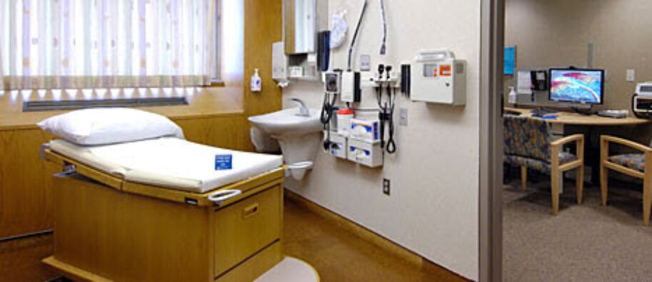
Patient-Centered Design
Mayo Clinic Center for Innovation
Researched consult rooms with interchanging design features for 30 days.
Vast majority of consult time is spent in conversation, with a short physical exam.
"Jack and Jill" rooms created a better experience for patients AND physicians.
http://centerforinnovation.mayo.edu/jack-and-jill-rooms/
Notes:
CLARE: Before we get into the technology that CBORD is working on, I wanted to share some examples of user-centered design (or patient-centered design) in healthcare. This is a really important focus right now and people are doing some really innovative stuff.
This example comes from the Mayo Clinic Center for Innovation and they were looking for a way to improve the experience of a doctor office visit. If patients are more comfortable, they are able to more fully understand and participate in their care.
Explain slide...

Slide 16

Patient-Centered Design
Kaiser Permanente - Nurse Knowledge Exchange
Nurse Shift Change
Patient Participation in handoff, at the patient's bedside.
New application to standardize the info needing to be communicated.
Results: patients do not experience a "gap in care", nursing staff feels confident they communicated everything important.
https://hbr.org/2010/09/kaiser-permanentes-innovation-on-the-front-lines
Notes:
CLARE: This is another great example of patient-centered design from Kaiser.
EXPLAIN SLIDE

Slide 17

CBORD's Commitment
Partner with our customers to determine priorities.
Build our User Experience and Design Department.
Invest in user research.
Notes:
CLARE: CBORD is committed to partnering with our customers and users to create a better experience. We've always sought feedback from our customers and users, and we are investing more deeply in user experience.
We are expanding our User Experience and Design Dept. We have the Director of that Dept, Will Ryan, here with us today and he'll be answering some questions for us later.
We are investing in user research and next we’re going to share a project we recently did and the results that came out of that.

Slide 18
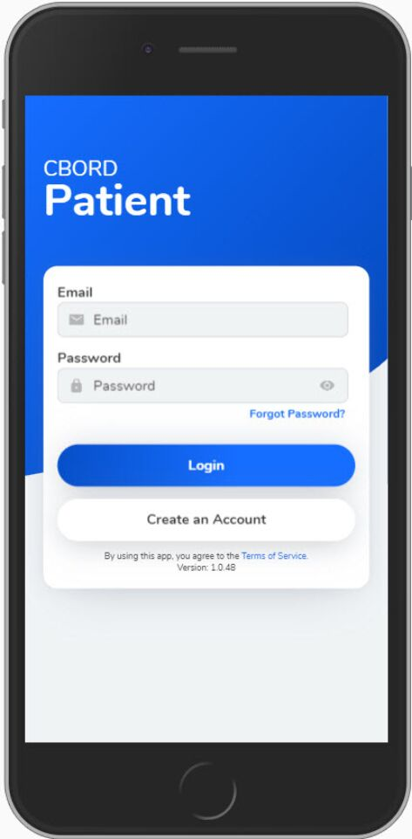
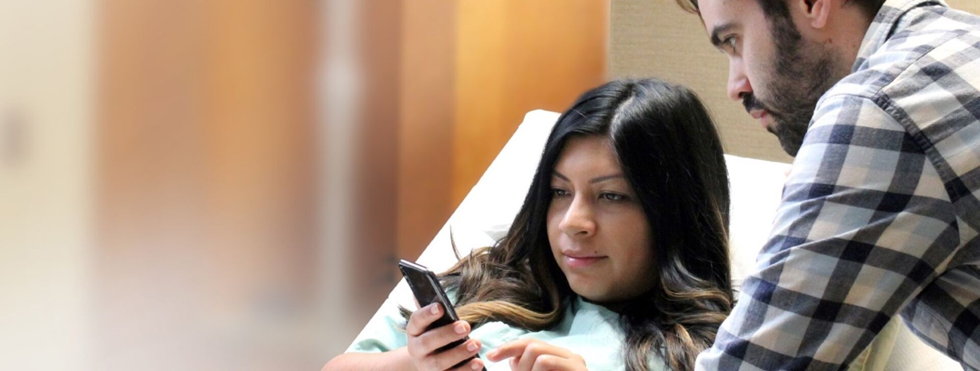
Notes:
We’ve been working on a new application called CBORD Patient. It allows patients to independently order food from the hospital’s menu. The menu in the app is customized for each patient, taking into account their diet restrictions, allergies and nutrition limits. Patients can log in, make menu selections, choose a delivery time and and place an order - all from the app. So...patients get the convenience of placing their order in real time and hospitals do not need to have a valuable staff member sitting in a call center to take those meal selections.
This product came about because we know that healthcare is progressing toward a future where patients participate in every aspect of their own care. Healthcare consumers no longer find it acceptable to be passive recipients of care. So, we know we have to arm patients with the right information at the right time to help facilitate their nutrition care. But we’ve also seen the negative consequences in healthcare if user-centered design is not prioritized.

Slide 19
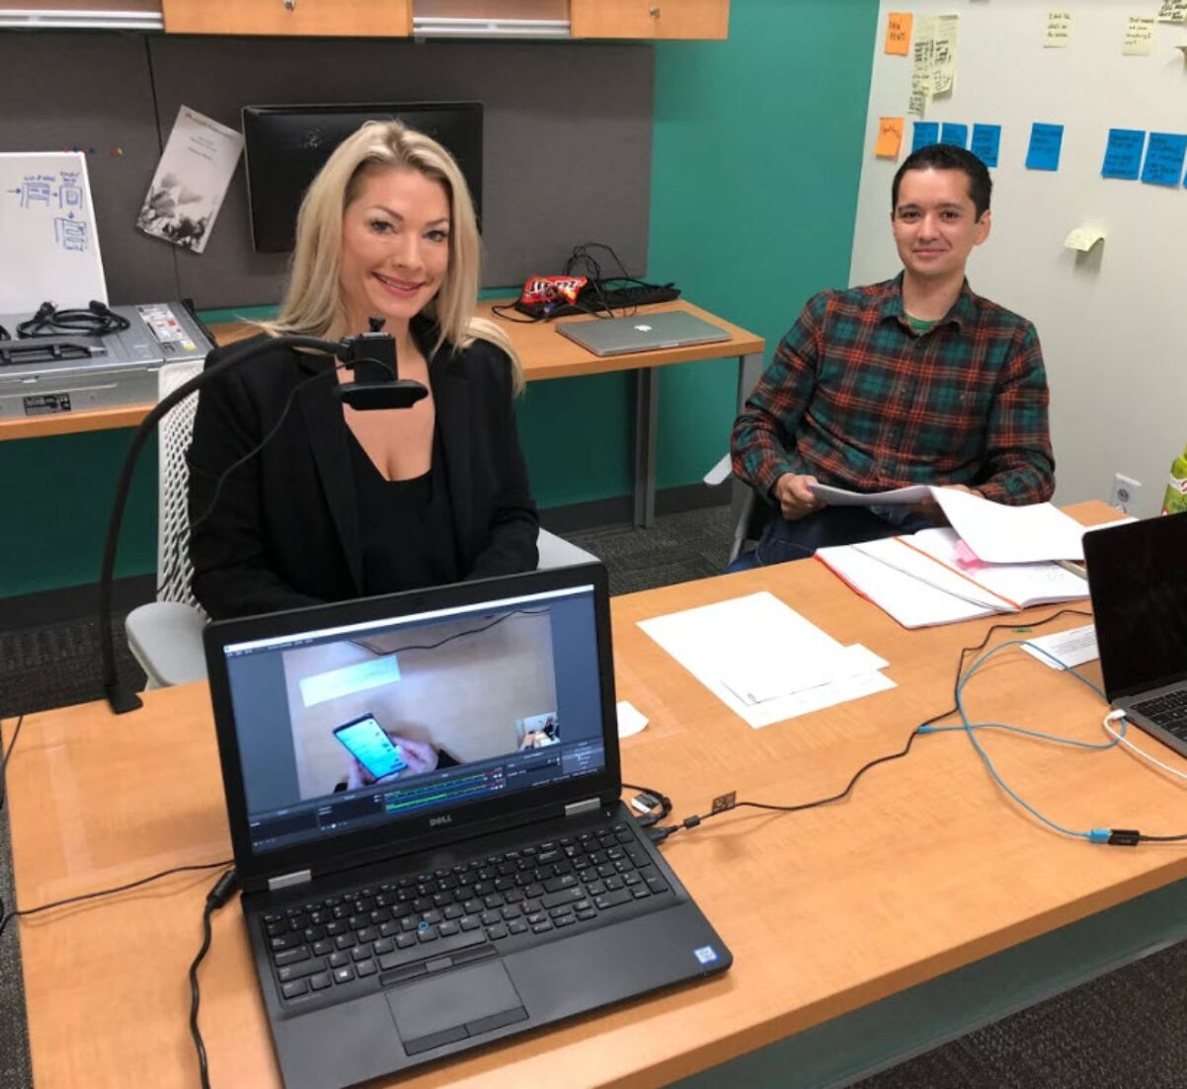
CBORD Patient
User Testing
User Group Conference 2018
Notes:
CLARE: Last year as our team was moving toward releasing our first version of the CBORD Patient app, we felt pretty good that it would meet the requirements of our customers, for a version 1 release. But everyone on the team was really wondering....will patients actually use it? Will they understand what to do? So, in addition to all of us putting the app in the hands of our friends and family and asking them to test it, we decided to ask attendees of our User Group Conference to help us out.
We recruited about 20 UGC attendees to participate as testers. We asked them to play the role of patients in a hospital and we spent about 30 minutes with each of these participants over the course of two days. When they arrived for their session, we put a hospital bracelet with their patient admission info on them and asked them to download the CBORD Patient app onto their own phone from the app store.
The test was moderated by Will Gelder and Brandon Moore, two of our designers from CBORD . Can you guys tell us about the method you used for testing?
WILL:
- Fellow designer Brandon Moore and I facilitated the testing. One of us guided the participant while the other took notes and asked followup questions.
- We had a camera set up to record what was happening on the screen, as well as another camera to record all of us. Body language is a form of feedback and so it was important for us to see how a person might physically respond to certain things.
- Each participant was assigned a persona with certain aspects. Each had their own diet, whether they were dining alone or with their family, whether or not they they were a friend of the patient. Things like that.
- And we asked them to complete a number of tasks involving signing up and ordering meals. Being careful not to provide any hints or assistance, or use language that would influence they're thinking. If someone became truly stuck, we would then make note and offer to move on.
- Testing in this fashion provided a ton of useful information. [NEXT SLIDE]

Slide 20

What We Learned
1. Registration and login were difficult.
2. Complex tasks caused confusion.
Notes:
WILL: One of the first things that stuck out to us is that people struggled with the Registration process. All of the testers were able to place meal orders, but we saw hesitation on some of the more complex tasks we asked them to do. And we knew that this app was going to be a consumer app used by patients, so it really needed to be intuitive.
BRANDON: Right, plus we want it to be quicker and easier for patients than it is for them to pick up the phone and call the room service call center. So, let’s talk about what happened next once we had all this info.
[NEXT SLIDE]

Slide 21
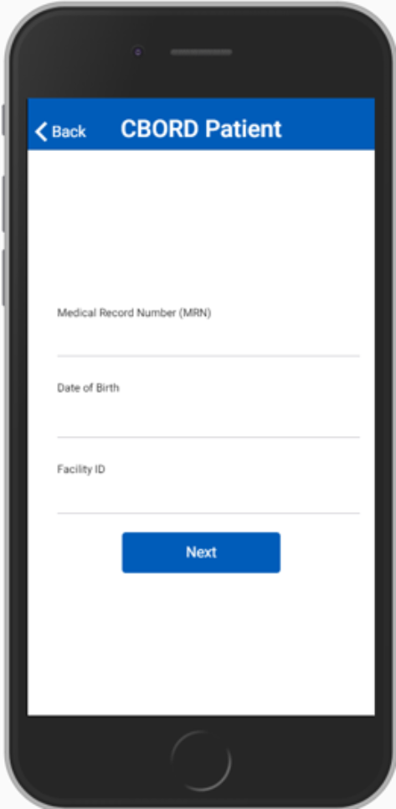
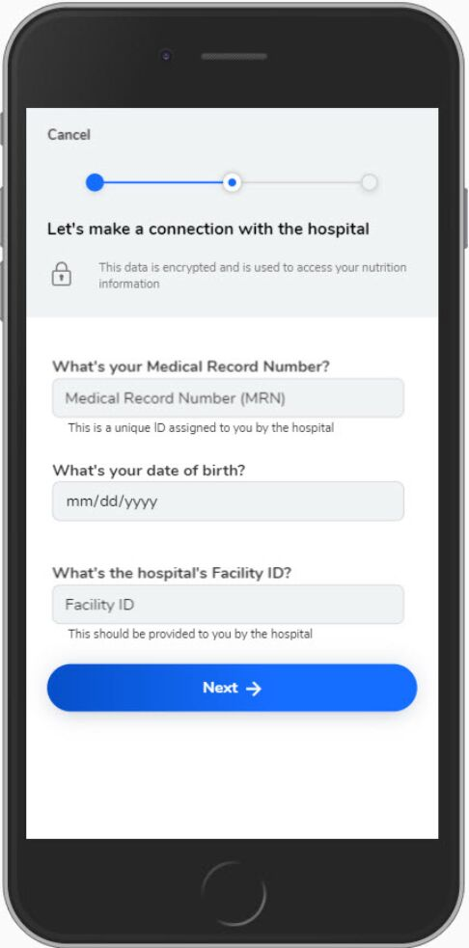
Before
After
Notes:
WILL: Like I said, users were unsure during the registration process.
They didn't know what a MRN was.
The Date of Birth input field was hard for people to use - and they accidentally chose the wrong date.
When we thought about solving these problems for patients we approached the design from a place of empathy. Hospitalized patients may feel nervous or confused. There is so much going on around them. We want them to have all the information they need and feel reassured that their privacy is being protected.
- With that information, we decided to augment this screen with a progress meter to convey where the patient was in the onboarding process.
- Patient privacy is important and so we made sure to reassure them that they were indeed making a secure connection to the hospital
- We adopted a more conversational voice in our labeling and messaging to provide a more comforting feel.
- And we revamped the date picker to use a more standard control that people are used to.
- Finally, we revamped the look to make it more clear which elements on the screen were inputs versus a static text.
[NEXT SLIDE]

Slide 22
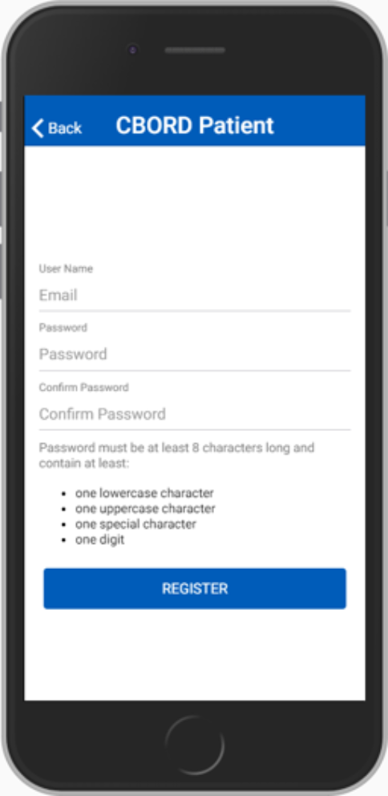
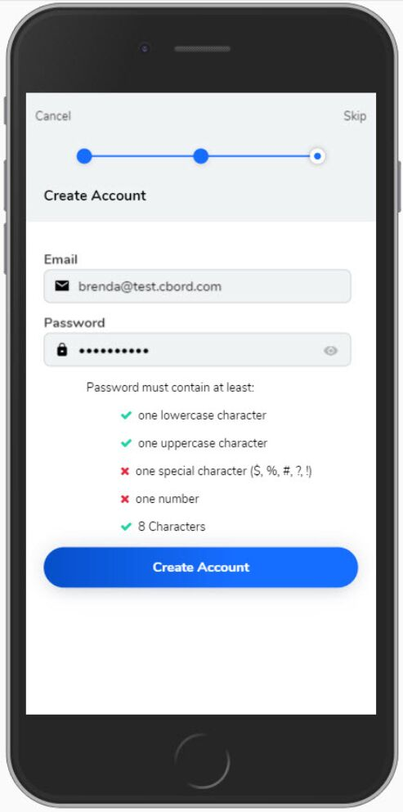
Before
After
Notes:
WILL: On the next screen, where the user has the option to create an Account we saw users mis-type their passwords or not meet all of the password requirements on the first try. This often added on average about 30 seconds to a minute more to the entire onboarding process.
- Since users weren't able to see their passwords as they type, they often mismatched and thus couldn't proceed.
- Users also didn't see the password requirements and often had to double-back to change their passwords.
We now allow them to see their password as they are typing it in, instead of making them confirm it.
Gave them real-time information about meeting password requirements.
They can also select the option of skipping registration altogether. They can still order meals without a login, they'll just need to enter their MRN, DOB, and Facility ID each time.
All of these enhancements were done with the idea of making this process more intuitive, faster, and more pleasant for the user.
[NEXT SLIDE]

Slide 23
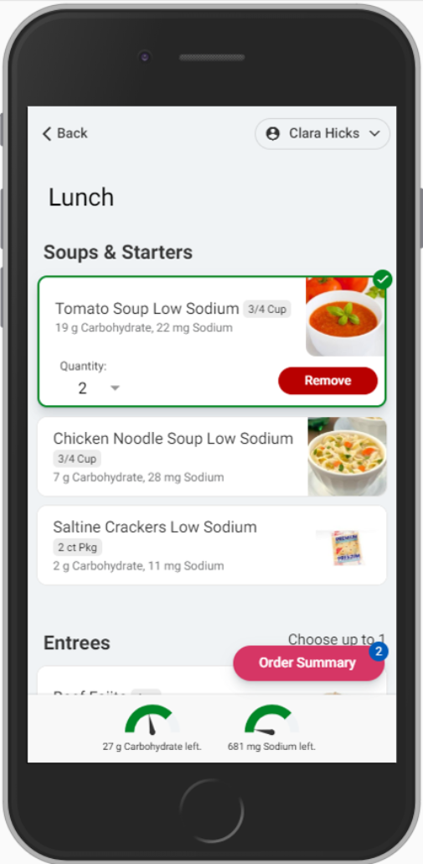
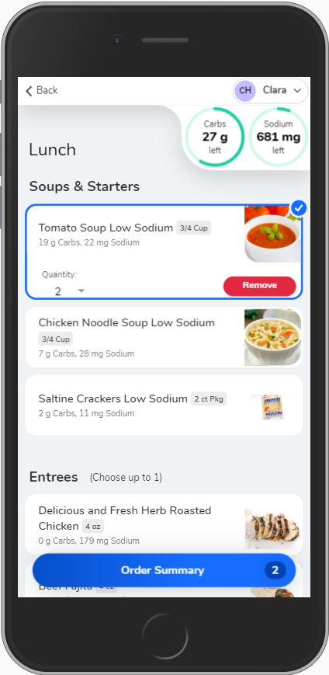
Before
After
Notes:
WILL:
- The core of the app is ordering meals. On the left, we have the initial design that we tested.
- Hospitals will often have limits on the number of items the patient can choose from from a particular category. For example, you can only choose up to 1 entree per meal. We saw people getting confused and try to select more than the limits allowed.
- We moved the messages closer to the category name and provided some more indicators when they've reached the limit for the category.
Moved nutrient gauges up by the name to associate them with the person.
[NEXT SLIDE]

Slide 24
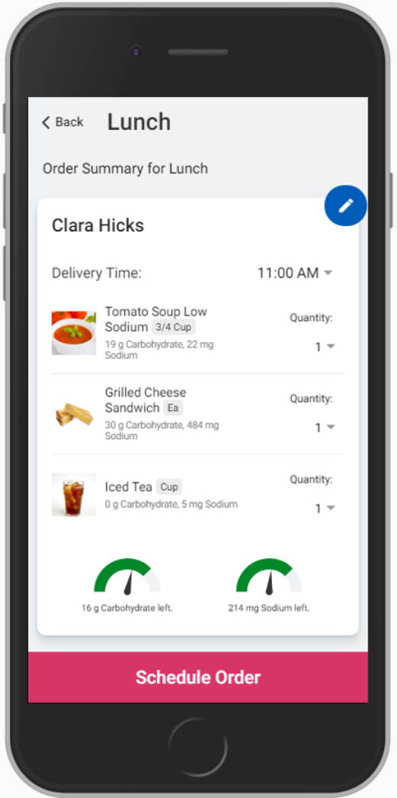
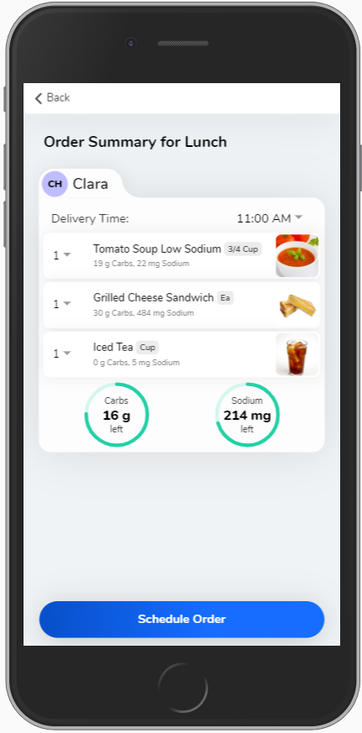
Before
After
Notes:
WILL:
- Here on the order summary, the patient reviews the items that they've selected, and either changes them or submits the order.
- Something else we saw when we asked users to place an order was that many did not know they could select a delivery time.
- To help with this issue, we removed a few elements off the screen and added more of a tab look. This makes the delivery time more obvious. Further user testing will tell us if we've done enough or if we need to keep working on it.
- So that's the core of the app, but we do plan on extending the functionality. What's in store next, Clare? [NEXT SLIDE]

Slide 25

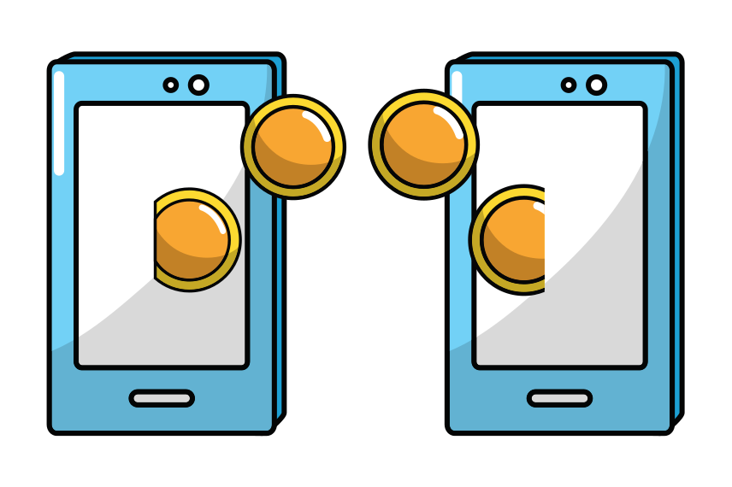
What We're Doing Next:
Alternative Access
FHIR implementation
Biometric Logins
Notes:
CLARE: Well, we're working on providing patients with alternative ways of accessing the app, because we know that one-size-does-not-fit-all when it comes to healthcare. We're in the testing phase right now of a FHIR implementation with the EPIC MYchart system. FHIR stands for Fast Healthcare Interoperability Resources and it's a fairly new interface spec used to connect apps with EHRs and patient portals. This will allow patients to sign in one time to EPIC Mychart and access our app from there. The patient will simply click a Meals icon, it will launch our app and EPIC will pass us their credentials in a secure FHIR interface, and then the patient can immediately start interacting with our meal-ordering app. That is slated to be ready in the 2nd quarter of this year.
We are also implementing the option of Biometric Logins in the app for patients who are using their own device. All of the biometric data is stored on the device, we do not store it or even access it. It's the same way that people can use facial recognition and fingerprint ID to open other secure apps, such as banking apps.

Slide 26

What We're Doing Next:
Addressing "scroll fatigue" with a Category Chooser
Notes:
CLARE: one of the usability challenges we're tackling next is giving users a way to navigate the menu that does not require them to scroll and scroll past foods that are not interested in. We know that hospitals are feeding patients with a variety of nutrition needs and preferences, so the menus can often be quite extensive. Obviously we would never present a patient with a food that isn’t appropriate for their diet or allergies, but we also want to give patients the tools they need to easily find what they’re looking for.
Currently in development and due to be released in the next few weeks is a category-choosing feature. This will allow patients to select a particular service course or category and have the menu auto-scroll right to it. One of the great things about this application is that when we release new features like this where we are enhancing the User Interface - users see it immediately. Just like any other app on your phone or tablet. So when the category chooser gets released in a few weeks, users will be able to start using it right away.

Slide 27
Notes:
CLARE: I’ll close out this portion of the presentation by saying thank you to all of our customers who are implementing this app or are interested in implementing. We’re looking forward to partnering with you on designing a batter patient experience.

Slide 28
PANELISTS
Megan Moore, BSN, RN
Kate Klindt
Angela Mason-Epper
Will Ryan, Ph.D
Clinical Lead
Ohio Health
Product Owner
CBORD
Senior Product Instructor
CBORD
Director of User Experience
CBORD
Notes:
CLARE: I am very pleased to remind everyone of the panel of experts we have with us here today. I have some prepared questions, and I hope all of you will submit your questions as well.
Megan Moore is a Registered Nurse and Clinical Lead at Ohio Health. She has been working as a RN for 5 years and recently assisted with the rollout of the CBORD Patient app on her unit.
Kate Klindt is a CBORD Product Owner with a specialization in designing and implementing solutions for enterprise heath systems. Kate has worked with over 400 different hospital nutrition departments, providing her with a deep understanding of the challenges and rewards of healthcare foodservice.
Angela Mason-Epper is a Senior Product Instructor at CBORD. She has been designing and delivering training programs to healthcare sites for 12 years. She is passionate about helping others be successful with technology.
Will Ryan is the Design Director of the newly formed User Interface and User Experience team at CBORD. He leads a team of designers, researchers, and developers to think about the problems facing our customers (and their customers) and find new ways to solve their pain points and address new gains for our products’ users. Will has experience as a design strategist, educator, leader, author, and advocate. After 4 years of research and teaching in higher education at Indiana University and Ithaca College, he transitioned into a leadership role of applying service design, usability, and UX strategy to solve organizational problems at Coca-Cola, NCR (focusing in the hospitality space), and now at CBORD and Horizon.
Thank you all for joining us. Let’s get started.

Slide 29
Where else is CBORD incorporating the principles of user-centered design?
Answering: Will Ryan
Notes:
This question is for Will Ryan. Read question.

Slide 30
Can the value of user-centered design be quantified?
Answering: Will Ryan

Slide 31
How do you implement the CBORD Patient app?
Answering: Angela Mason-Epper

Slide 32
How are patients responding to the idea of using an app for meal-ordering?
Answering: Megan Moore, RN

Slide 33
Who teaches patients and nursing about the CBORD Patient app?
Answering: Angela Mason-Epper

Slide 34
What do patients like about the CBORD Patient app? What could be improved?
Answering: Megan Moore, RN

Slide 35
What impact does this have on CBORD's Product roadmap?
Answering: Kate Klindt

Slide 36
What can we expect at CBORD’s User Group Conference this year?
Answering: Will Ryan and Kate Klindt

Slide 37
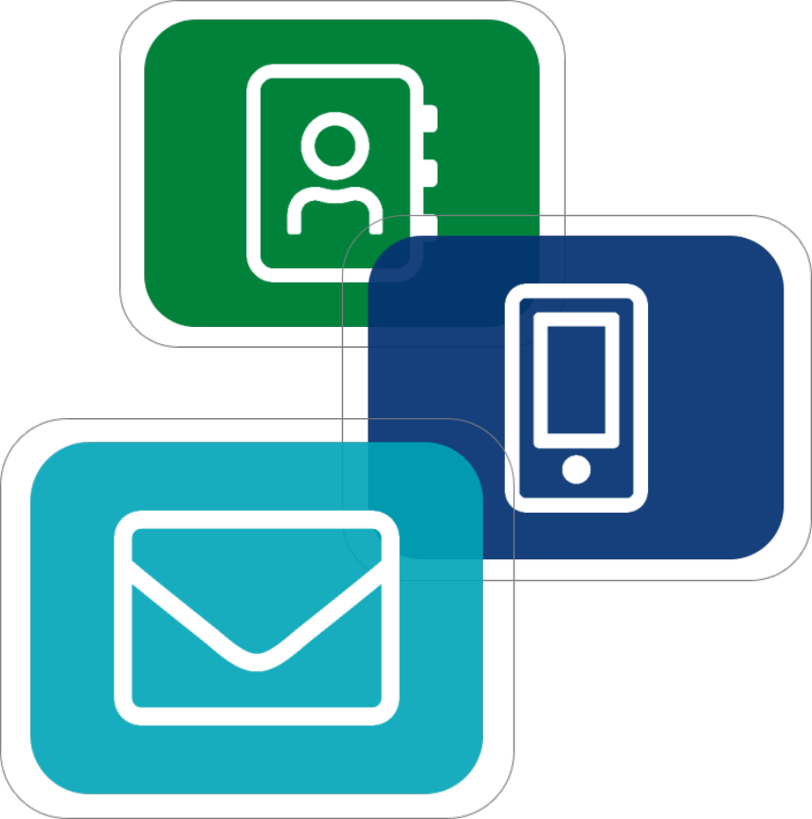
Contact Us
Will Gelder
wag@cbord.com
Brandon Moore bcm@cbord.com
Clare Hicks,
cmh2@cbord.com
Kate Klindt, Product Owner
klk@cbord.com
Angela Mason-Epper
alm@cbord.com
Will Ryan
wnr@cbord.com
Notes:
Our contact information is on the screen. Please don't hesitate to reach out to any one of us with questions.

Slide 38
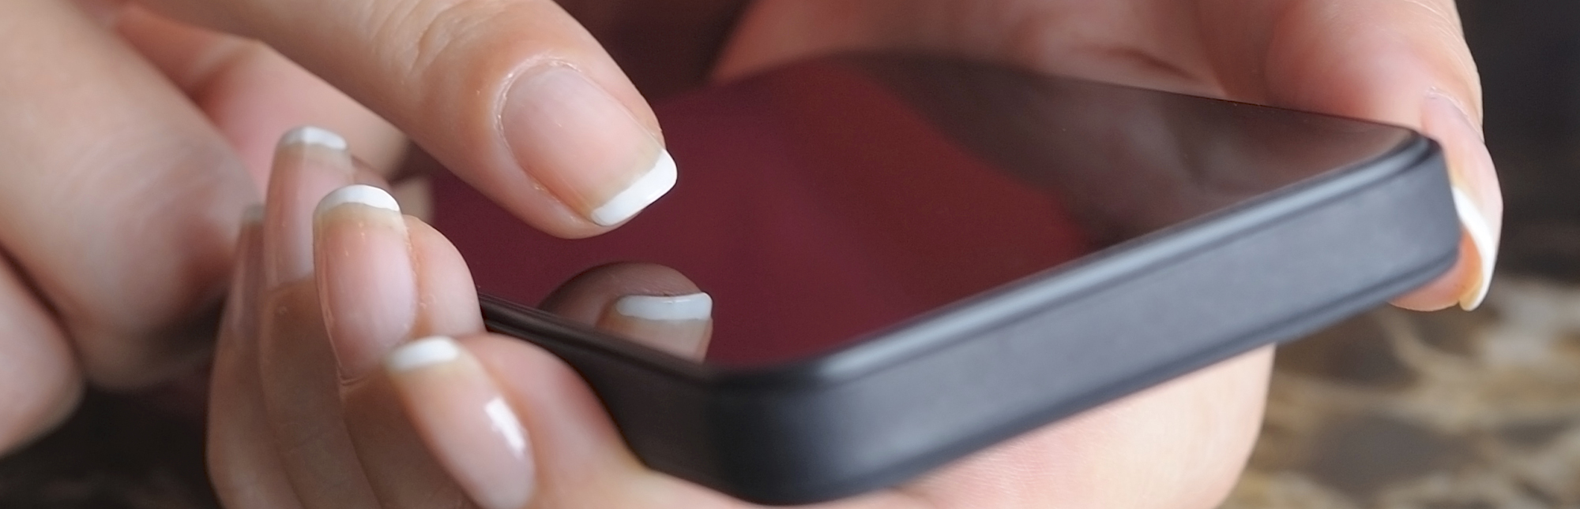





607.330.3922
www.cbord.com/webinars
Contact Nicole Sales Development Representative
950 Danby Road, Suite 100C
Ithaca, New York, 14850
nbe@cbord.com
Notes:
Thank you for attending this webinar. Please contact us Nicole to schedule an on-site demo for your organization.

